Slide 1
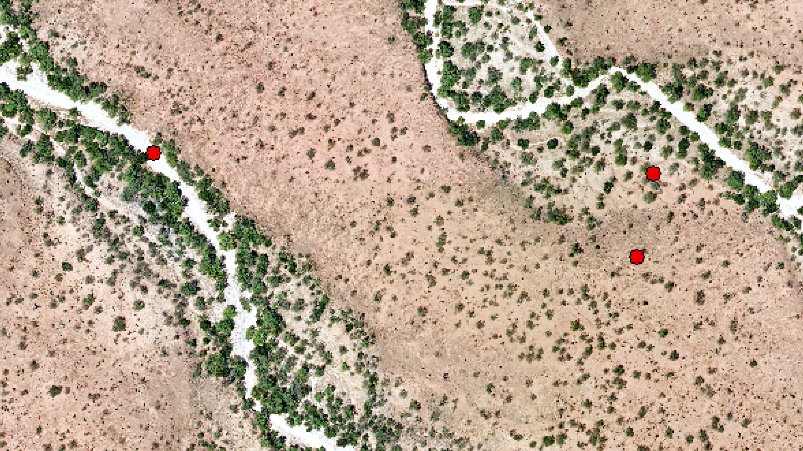
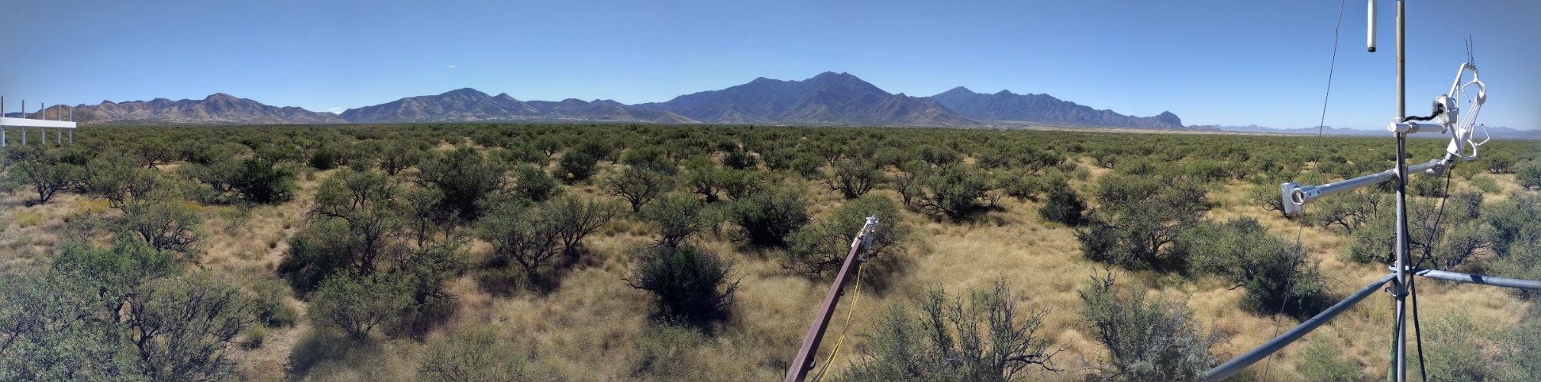
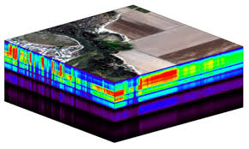
Image classification with HDF5 file
Rubaya Pervin

Slide 2
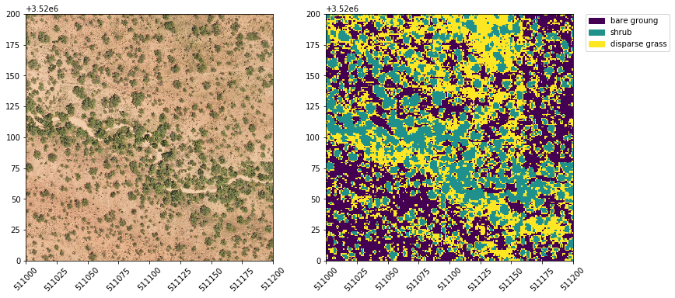
Classification
Identifying and labeling
Pure pixel
Fuzzy
Unsupervised
Supervised

Slide 3
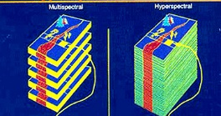
Hyperspectral image
Hyperspectral images:
Image cubes
Hundreds of spatial images
https://www.neonscience.org/hyper-spec-intro
https://www.sciencedirect.com/topics/computer-science/hyperspectral-image

Slide 4
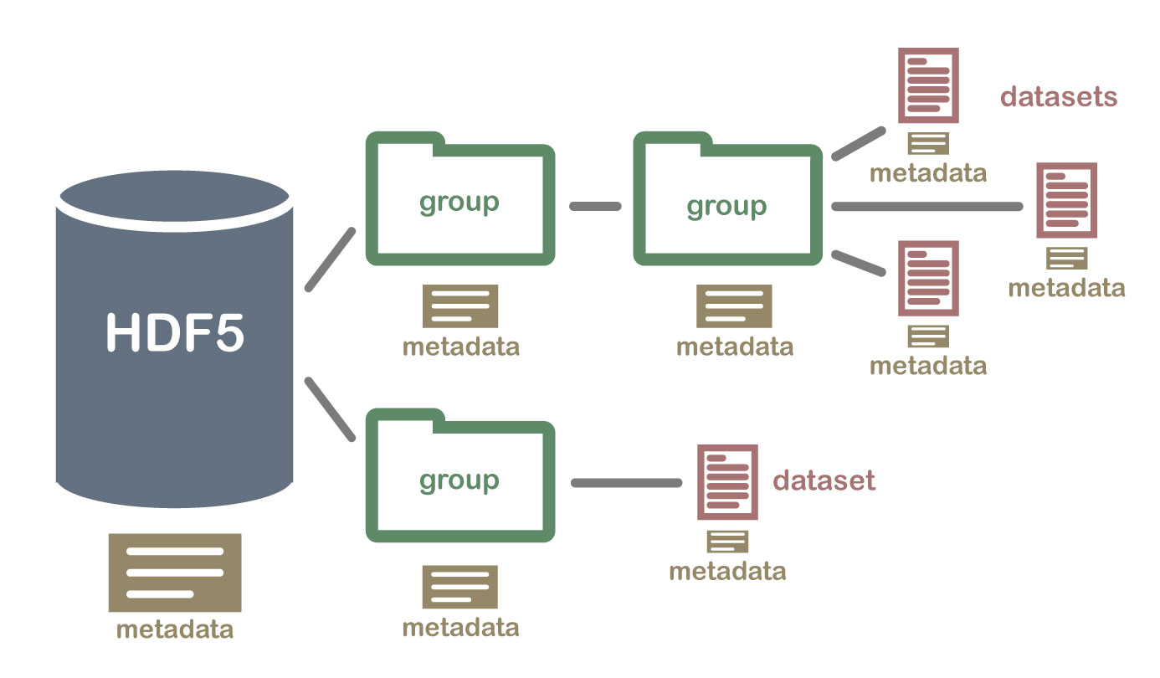
What is HDF5 file?
The Hierarchical Data Format version 5 (HDF5): open source file format that supports large, complex, heterogeneous data
https://support.hdfgroup.org/HDF5/doc1.6/UG/08_TheFile.html
https://www.christopherlovell.co.uk/blog/2016/04/27/h5py-intro.html
https://www.neonscience.org/about-hdf5
Source: https://www.neonscience.org/about-hdf5

Slide 5
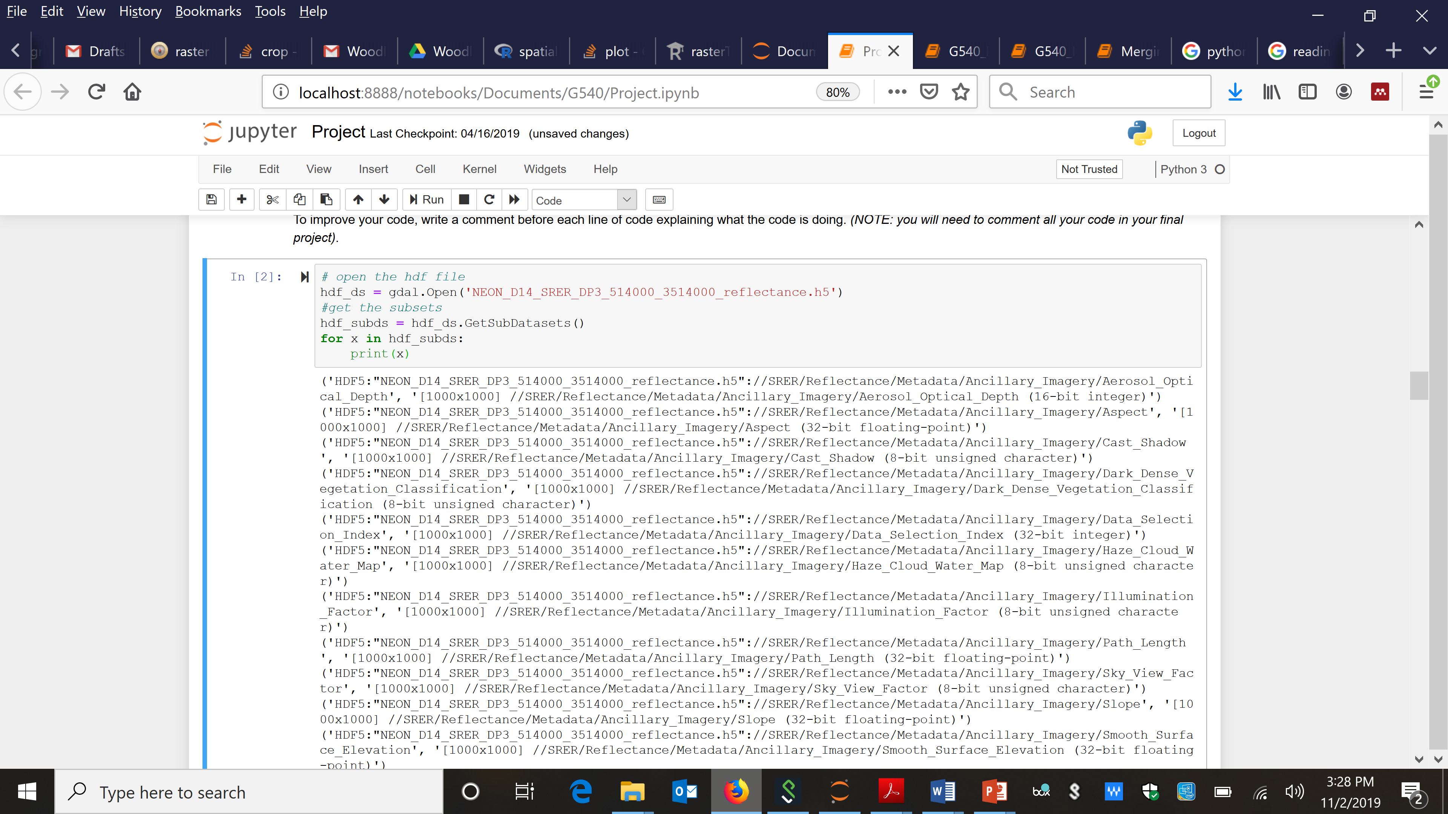
Understanding file system and getting information
HDF5 file format
Groups: work like dictionaries
Datasets: work like NumPy arrays
https://gdal.org/drivers/raster/hdf5.html
http://docs.h5py.org/en/stable/quick.html
import gdal

Slide 6
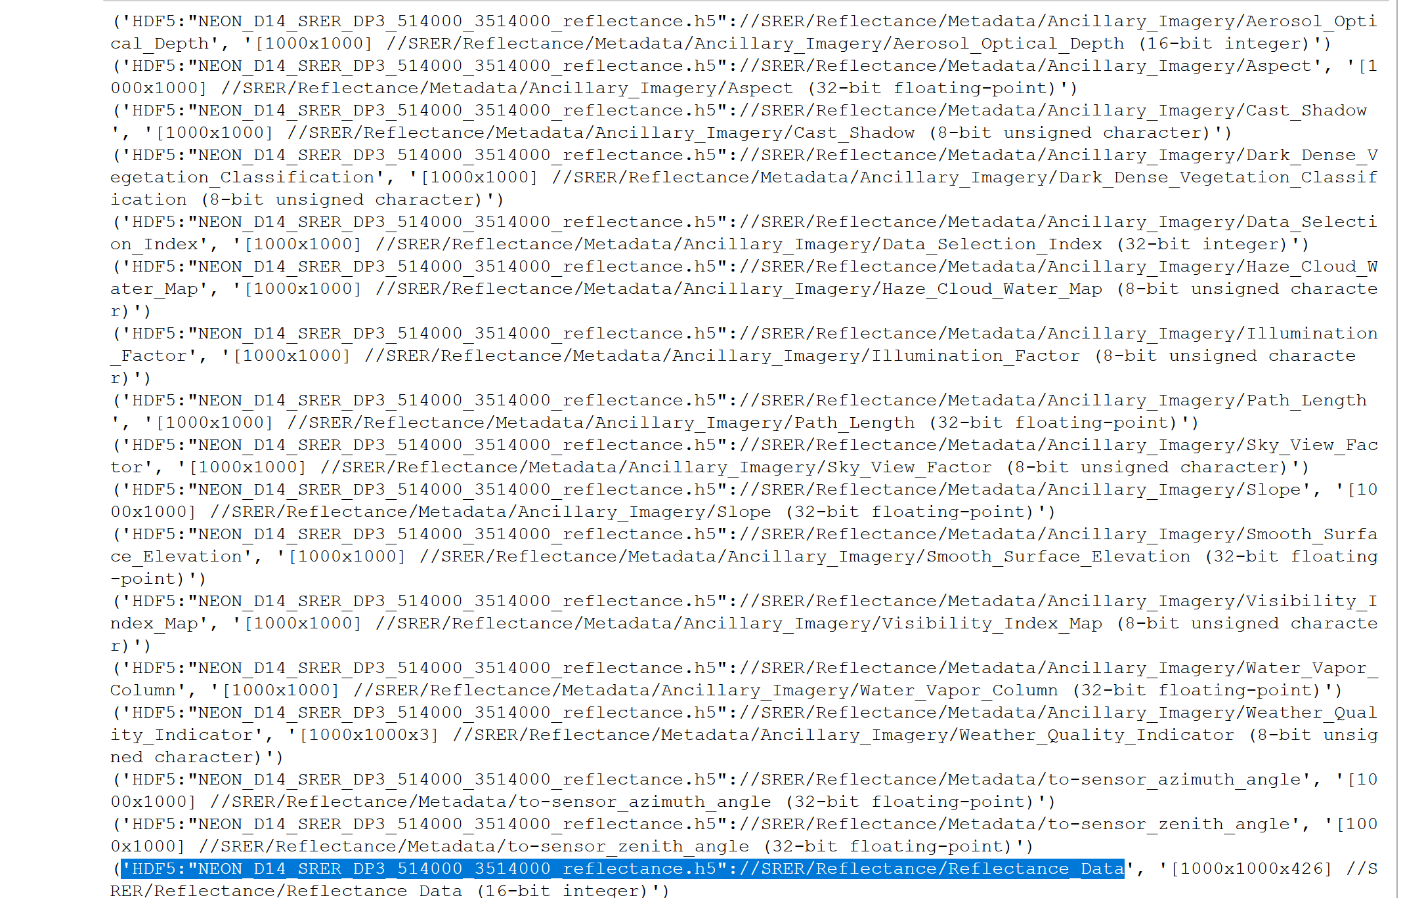
Understanding file system and getting information
Reflectance data

Slide 7
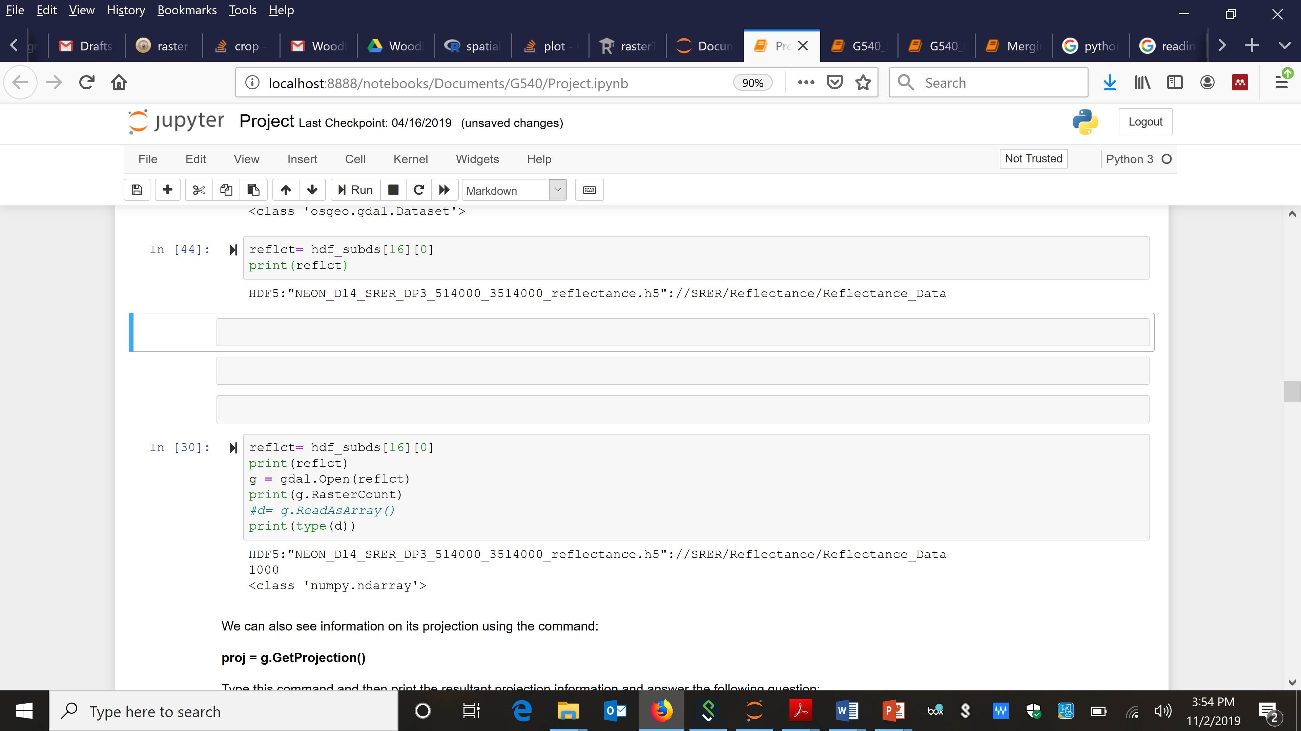
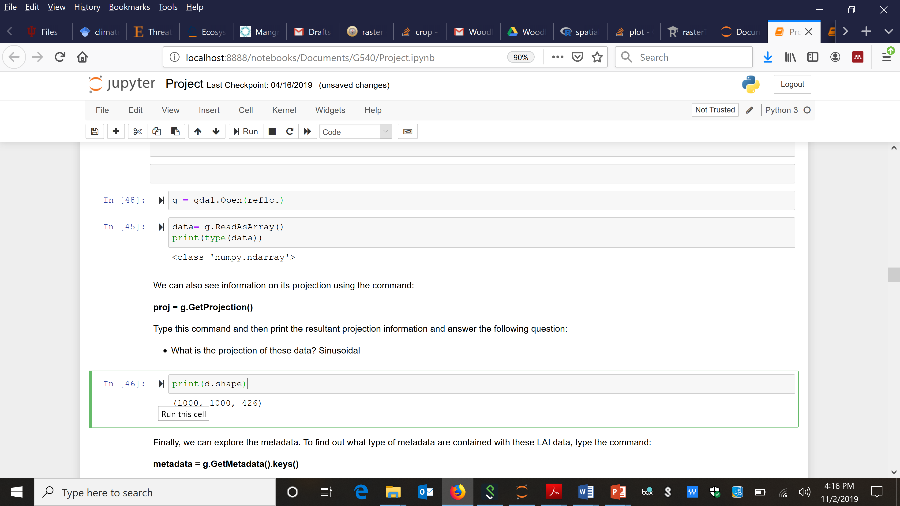
Understanding file system and getting information

Slide 8
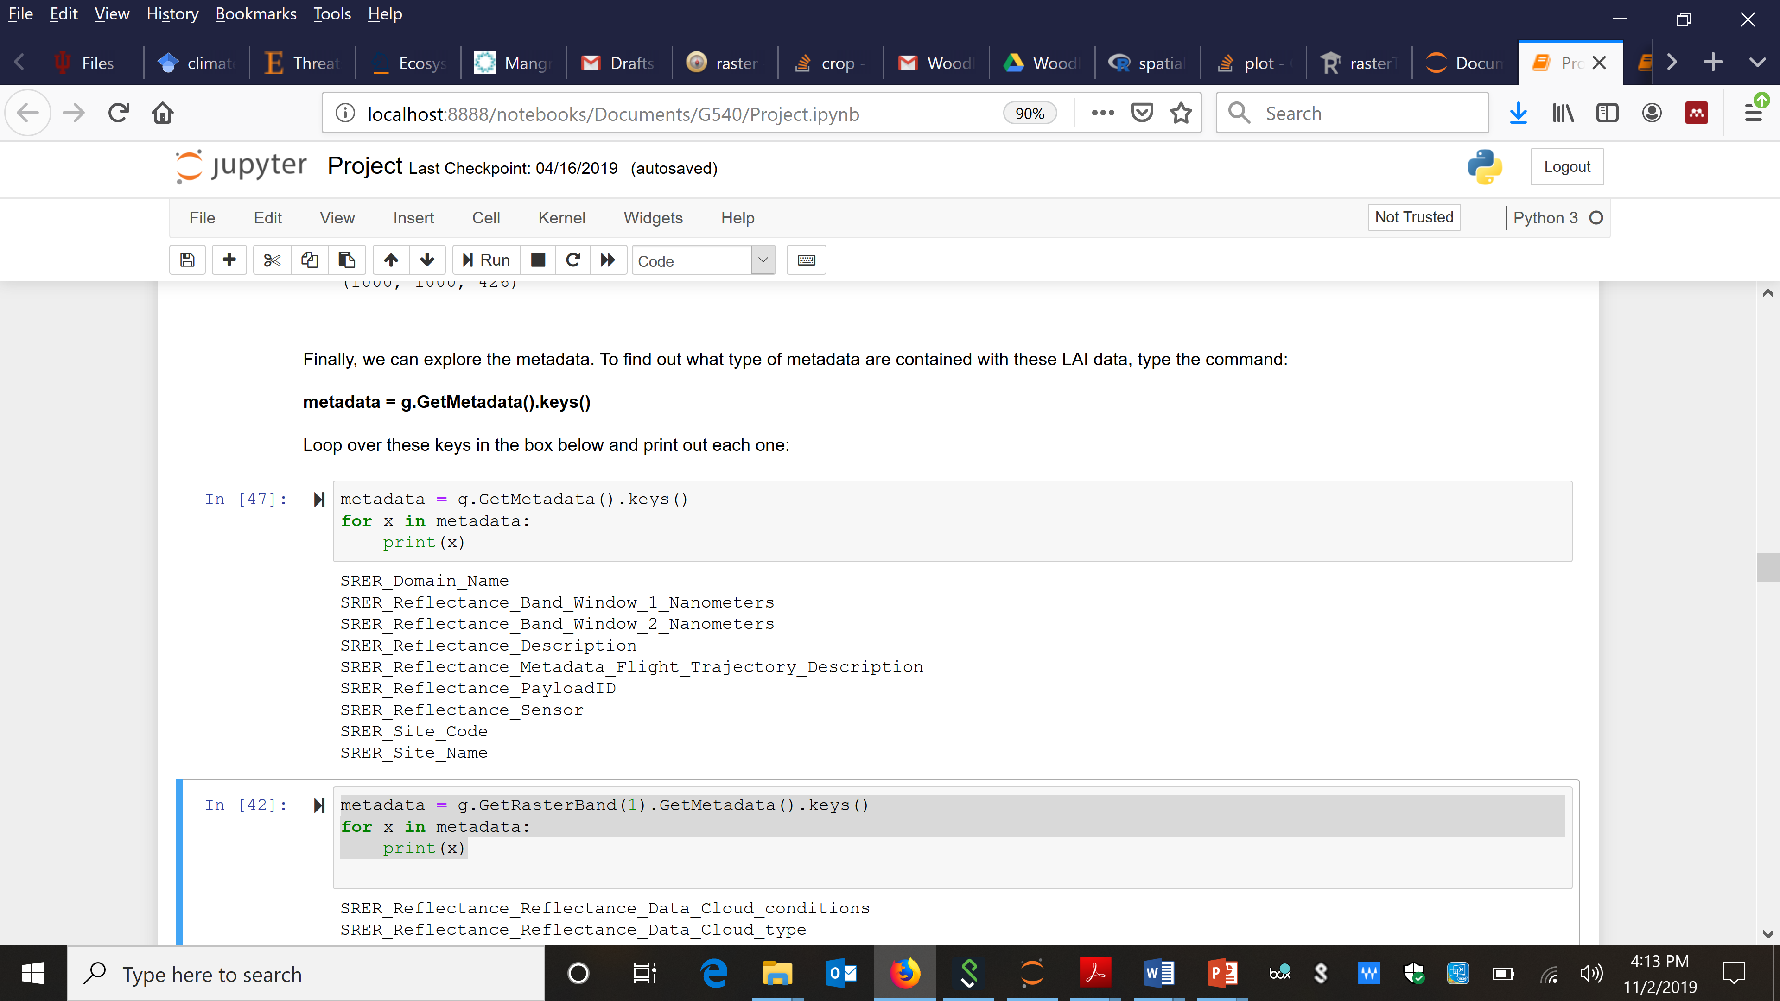
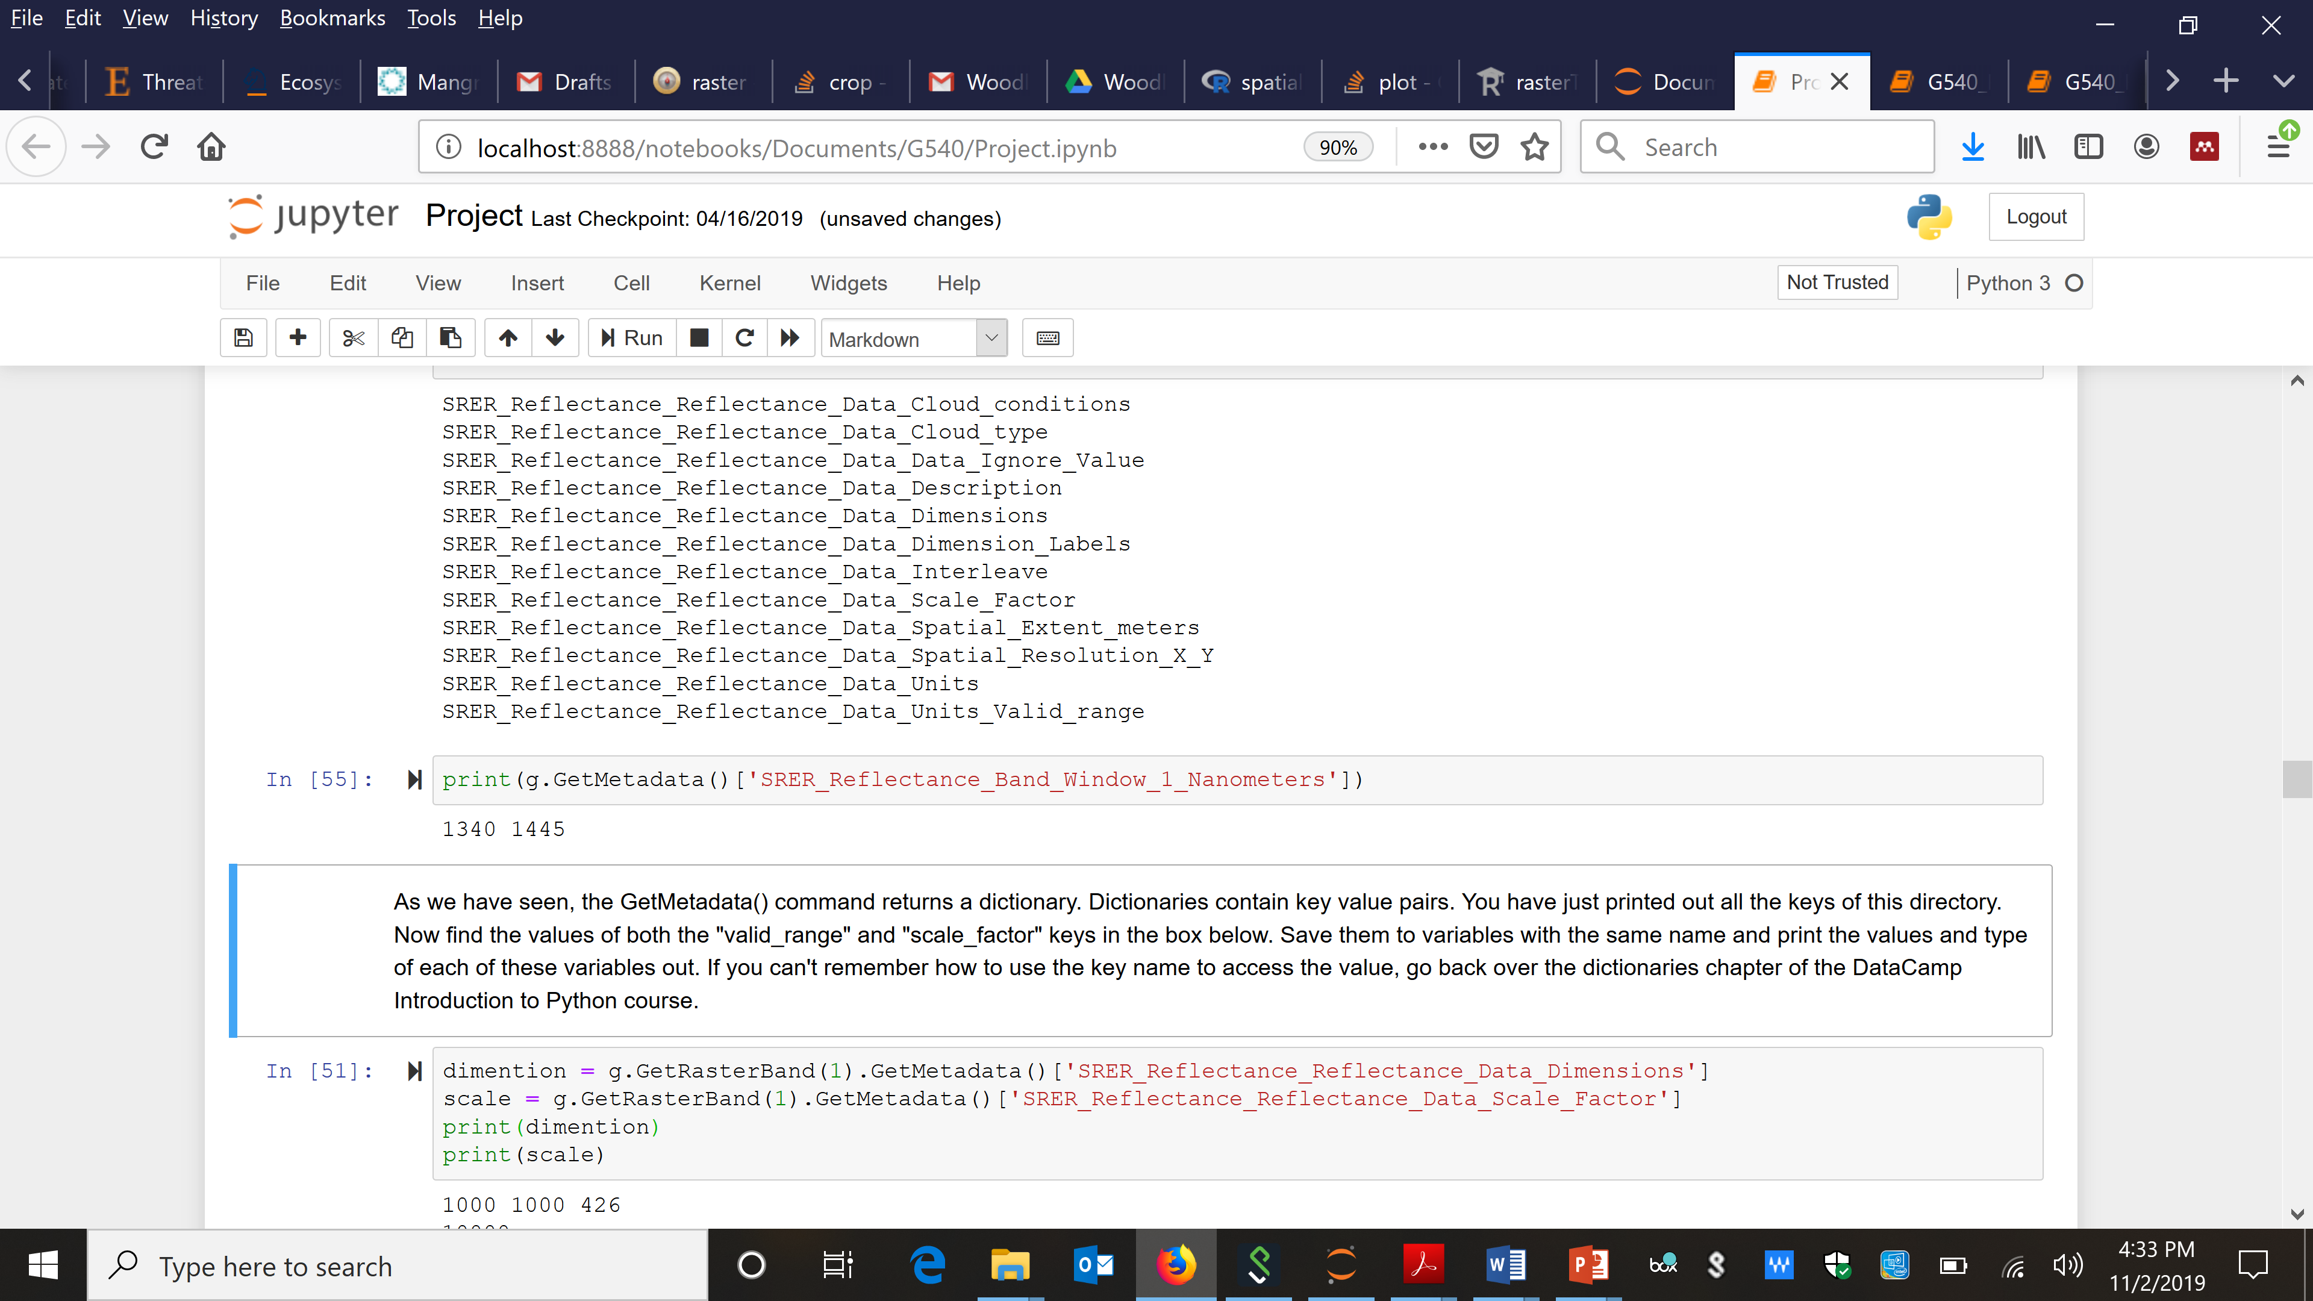
Understanding file system and getting information

Slide 9
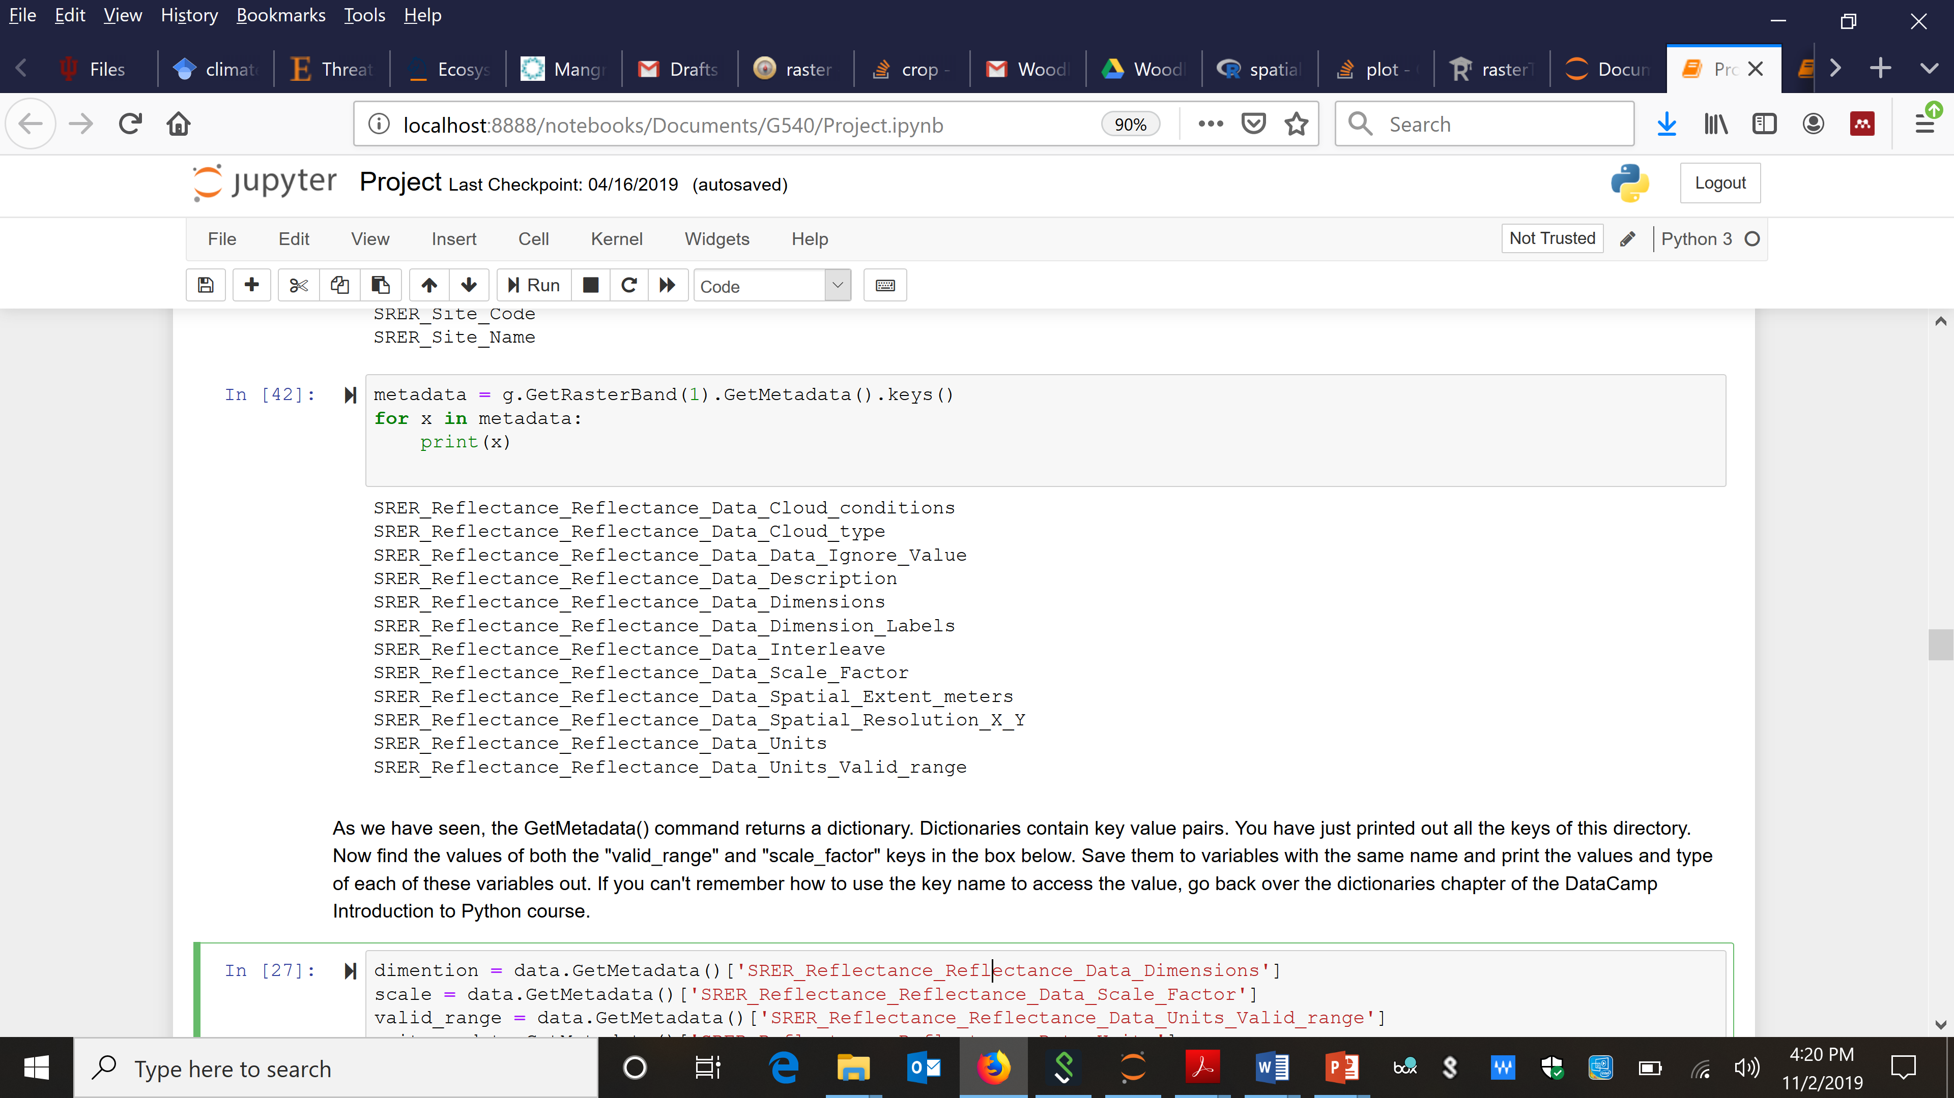
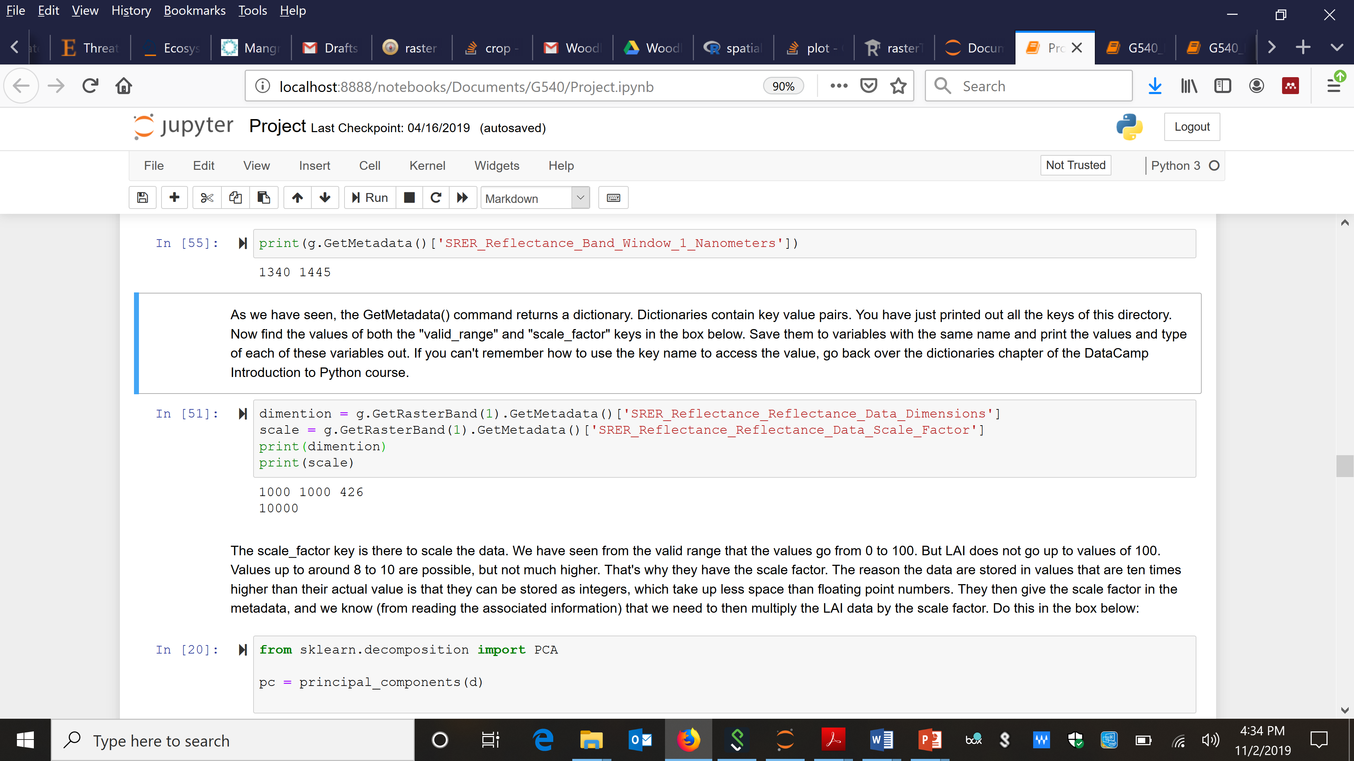
Understanding file system and getting information

Slide 10
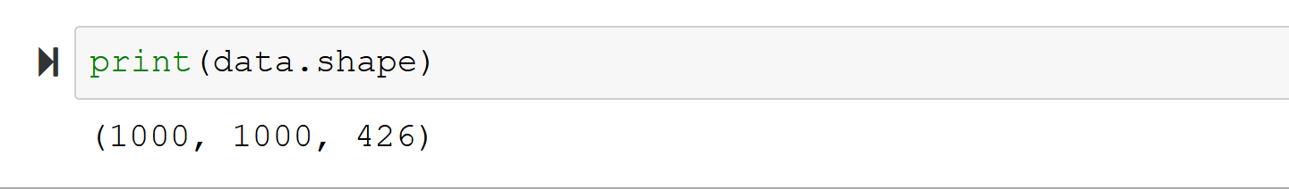
Understanding file system and getting information

Slide 11
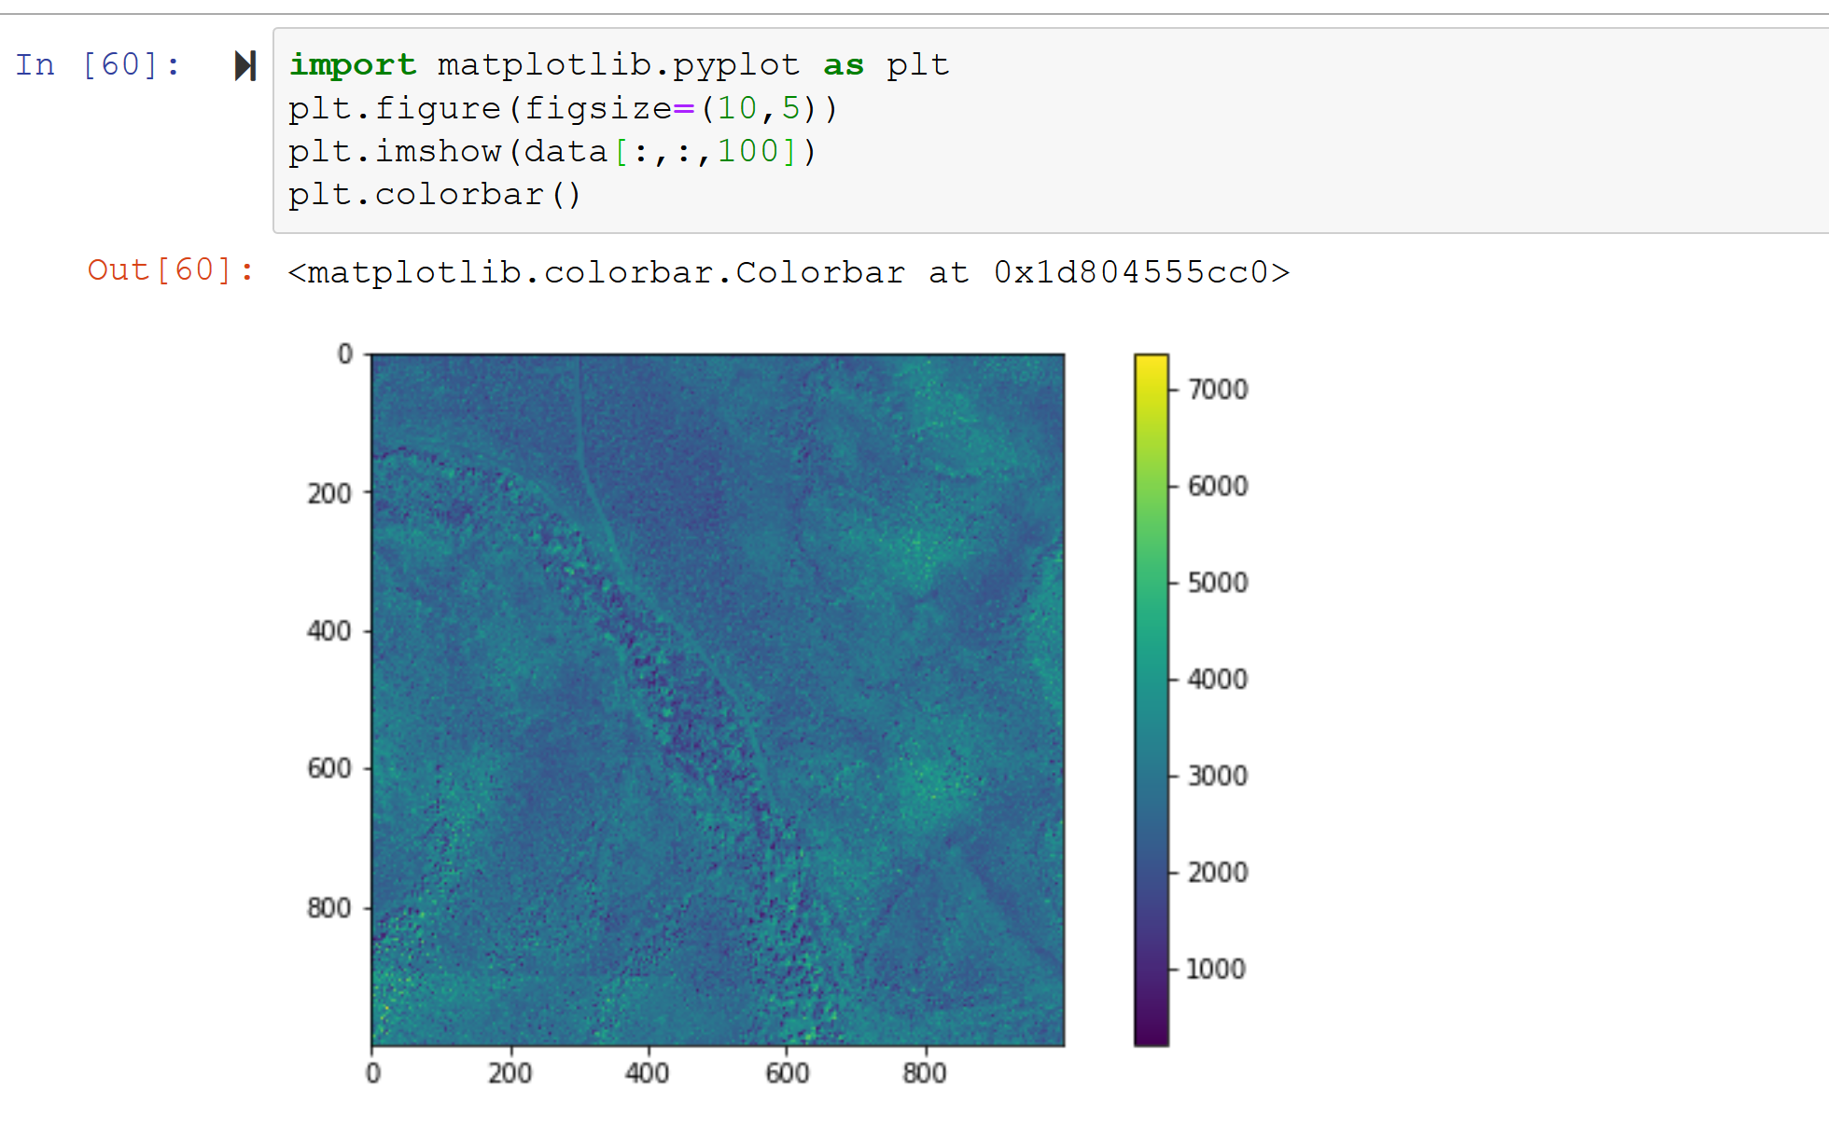
Understanding file system and getting information

Slide 12
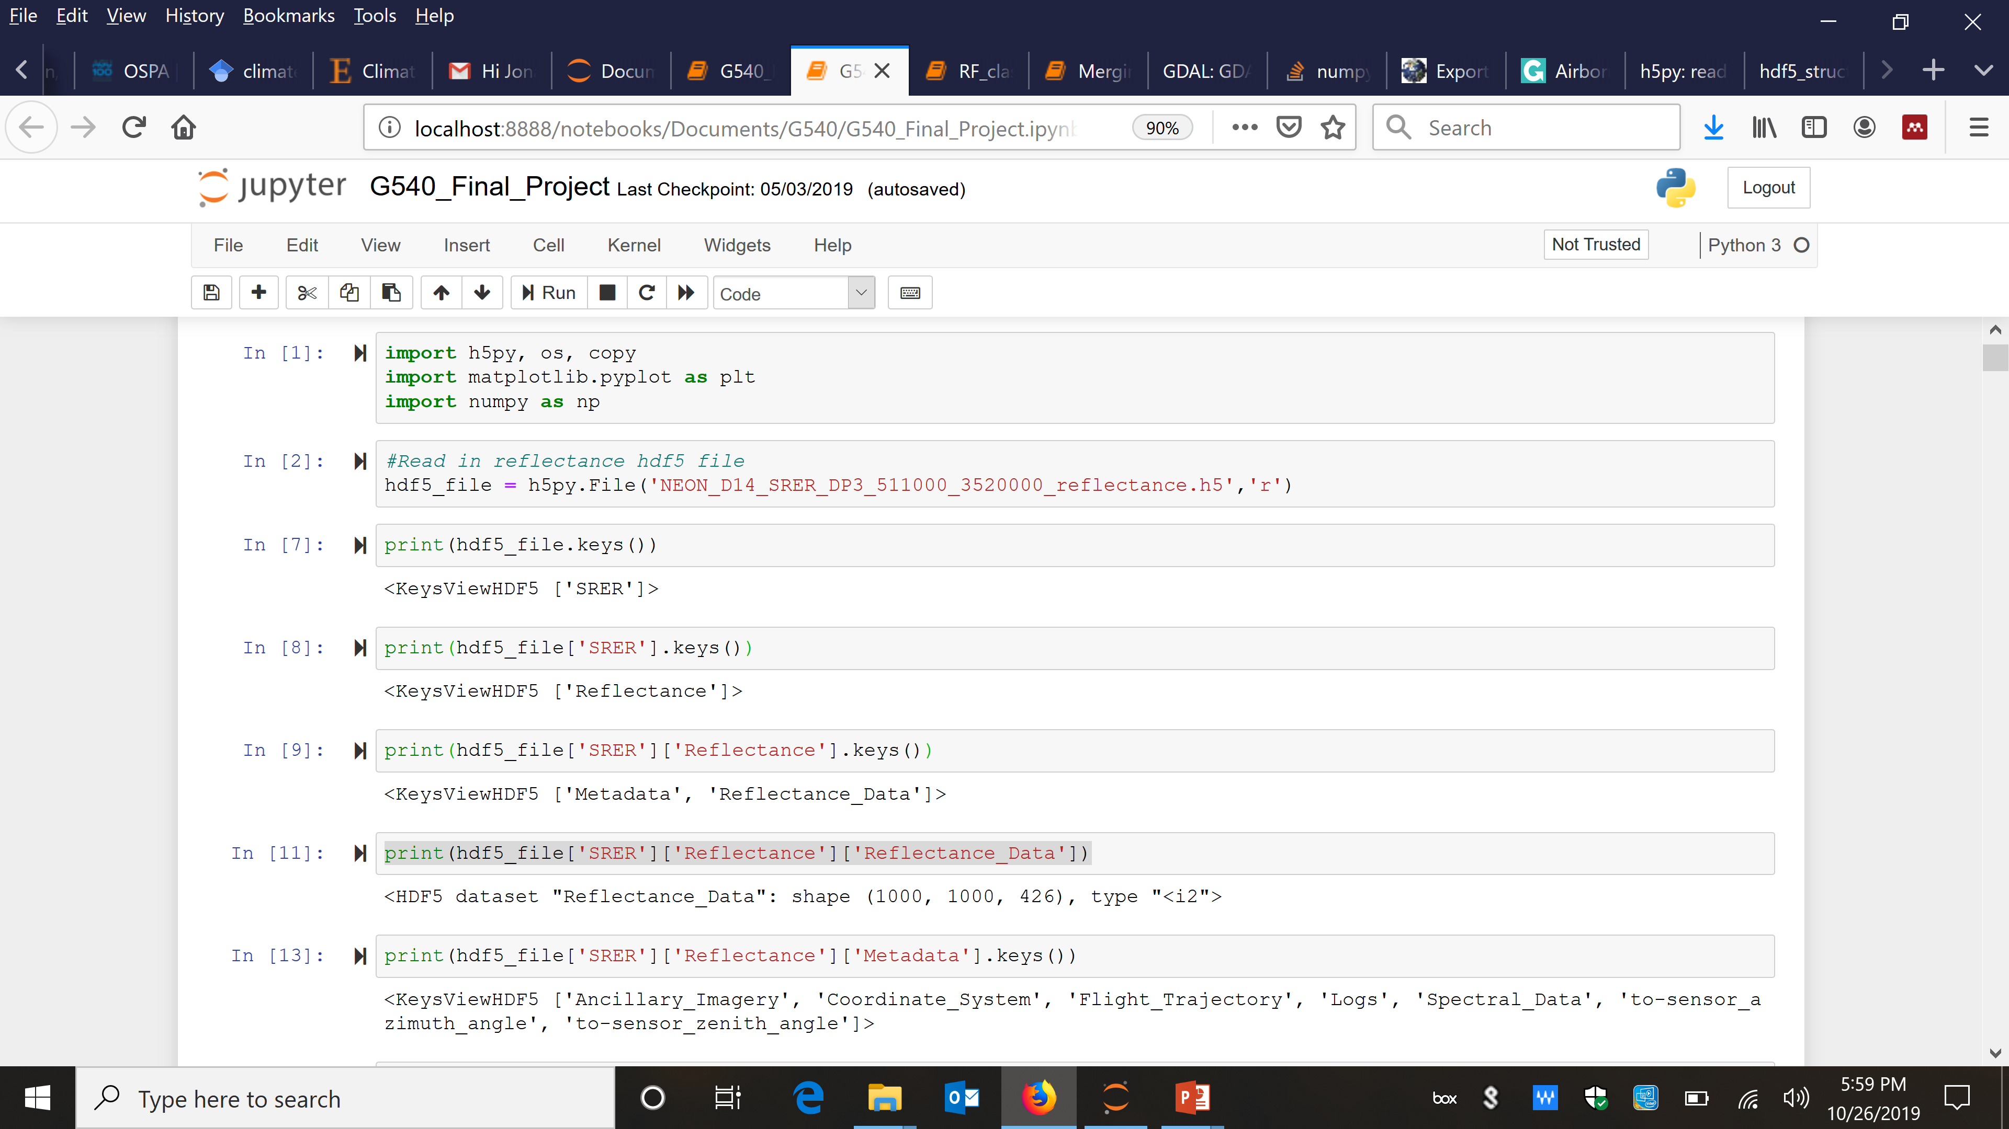
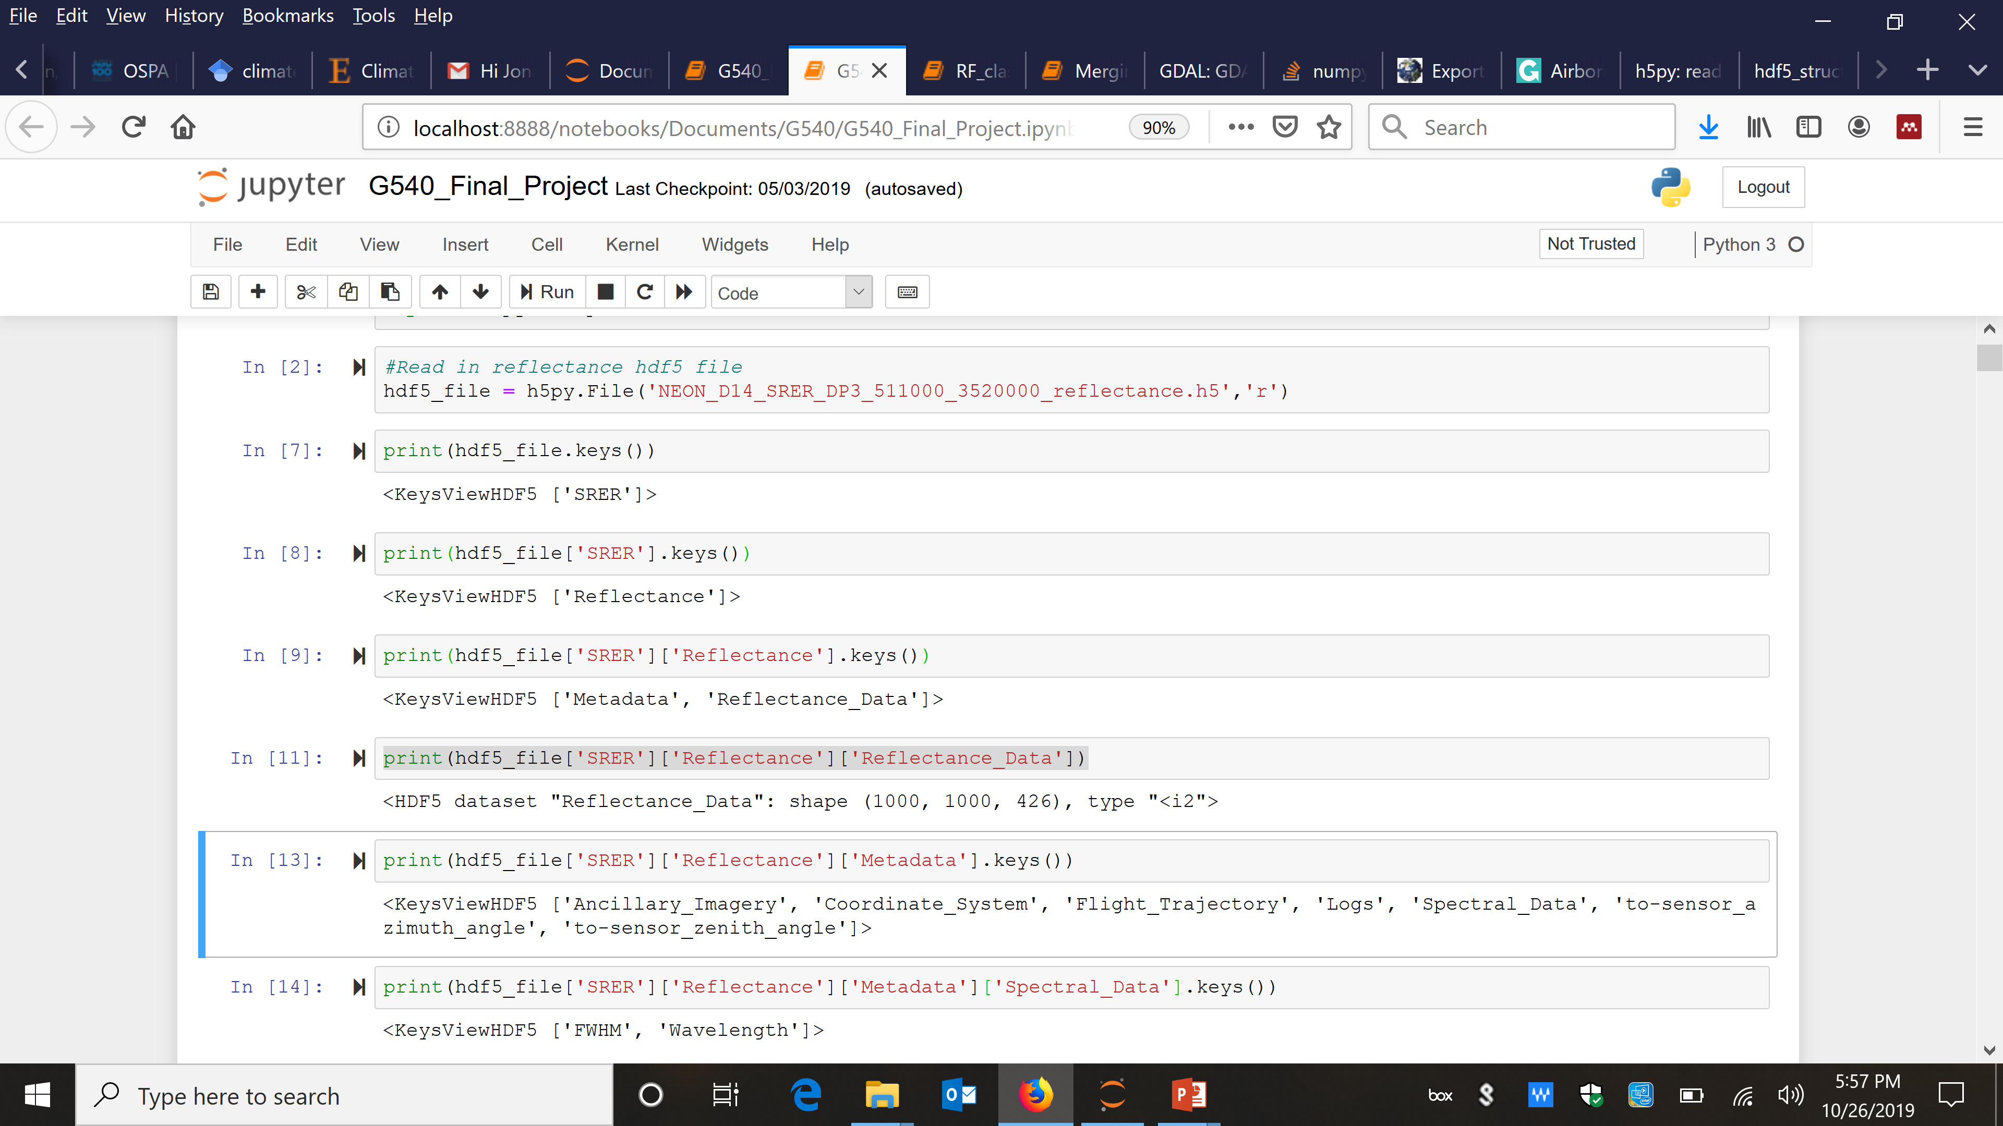
Understanding file system and getting information

Slide 13
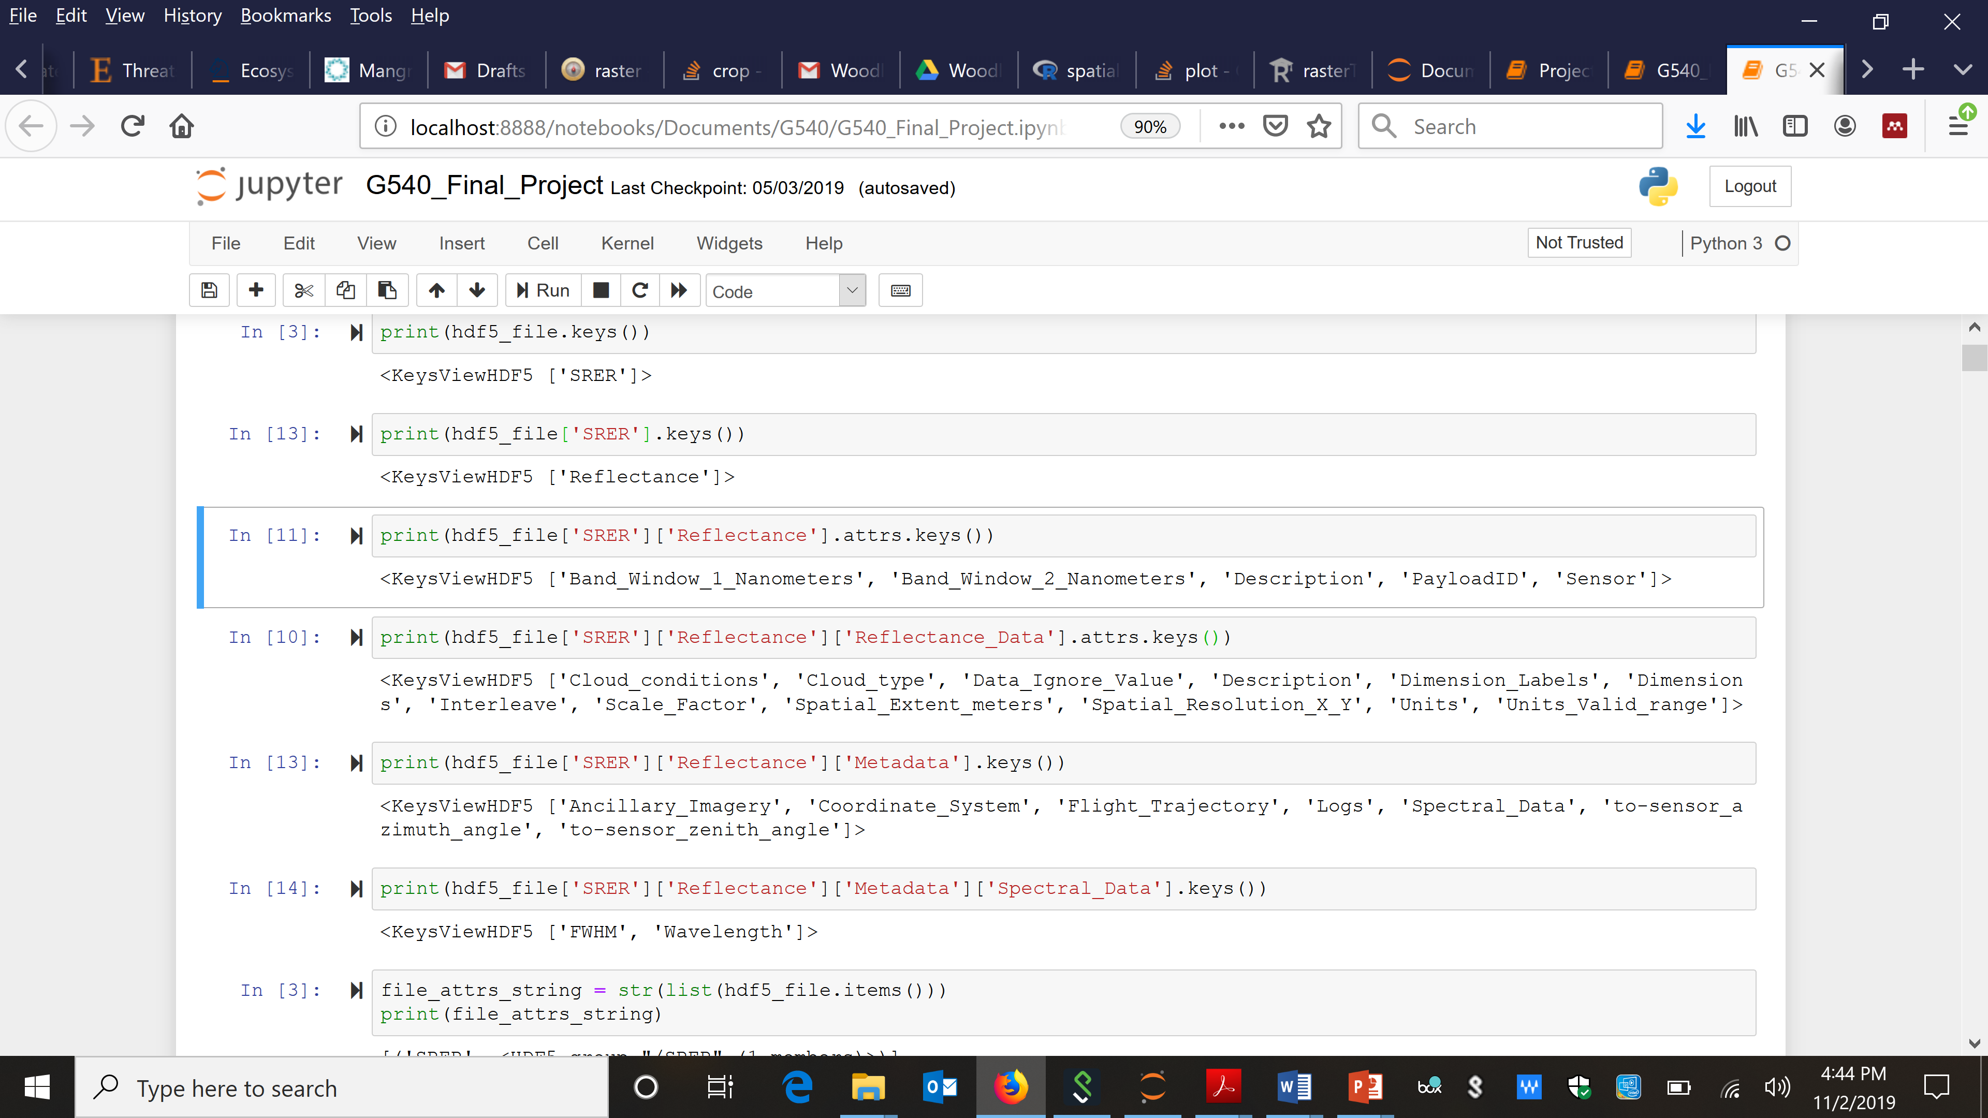
Understanding file system and getting information

Slide 14
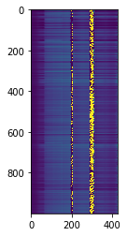
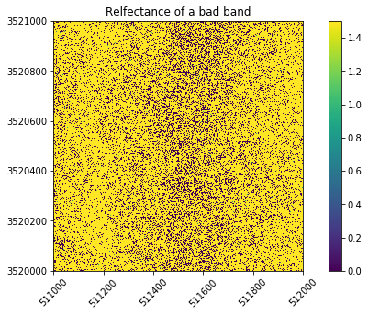
Data Cleaning
Data missing/ignor value: -9999 to NaN
Reflectance : Range 0-1
Scale Factor: 10,000
Given reflectance value/Scale factor
Any negative value to NaN
Bad band range mostly water vapor band
Reduced bands 426 to 360

Slide 15

Pure Pixel classification: K-Means Clustering
Unsupervised K-means Clustering
Determining cluster numbers (automated + prior knowledge)
Identifying clusters in Image (automated)
Assigning clusters to class (prior knowledge)
Source: https://mubaris.com/posts/kmeans-clustering/

Slide 16
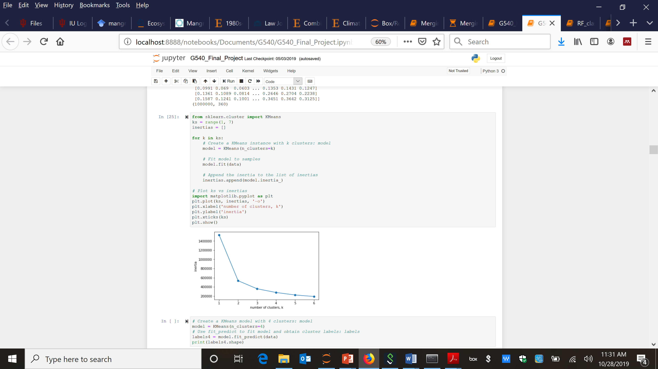
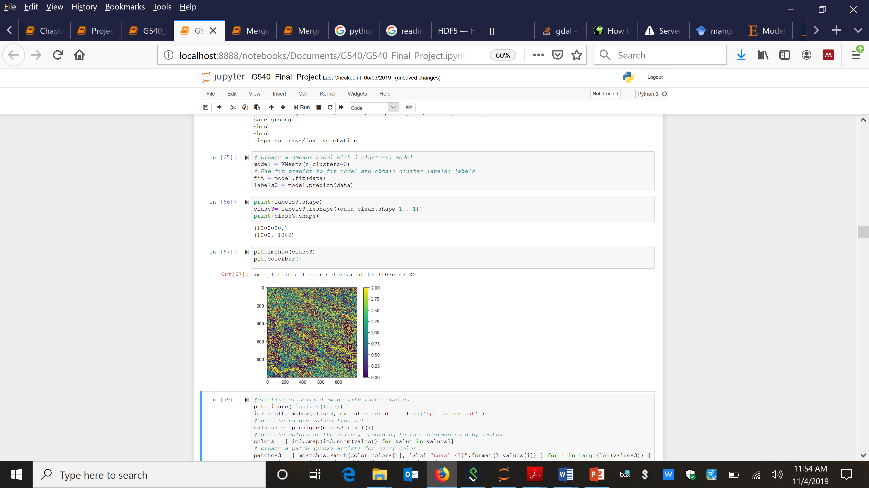
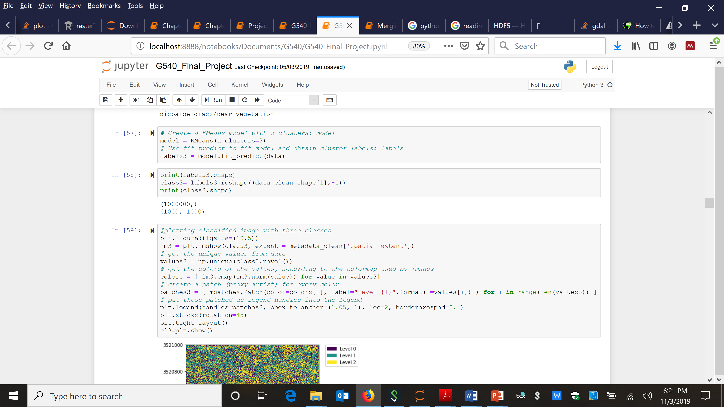
K-Means Clustering
3steps for classification
Step 1: Creating the model
Step 2: Fit clustering model to samples
Step 3: Assign class labels to each pixel of the data
Instead of separate step 2 & 3 you can combine them

Slide 17
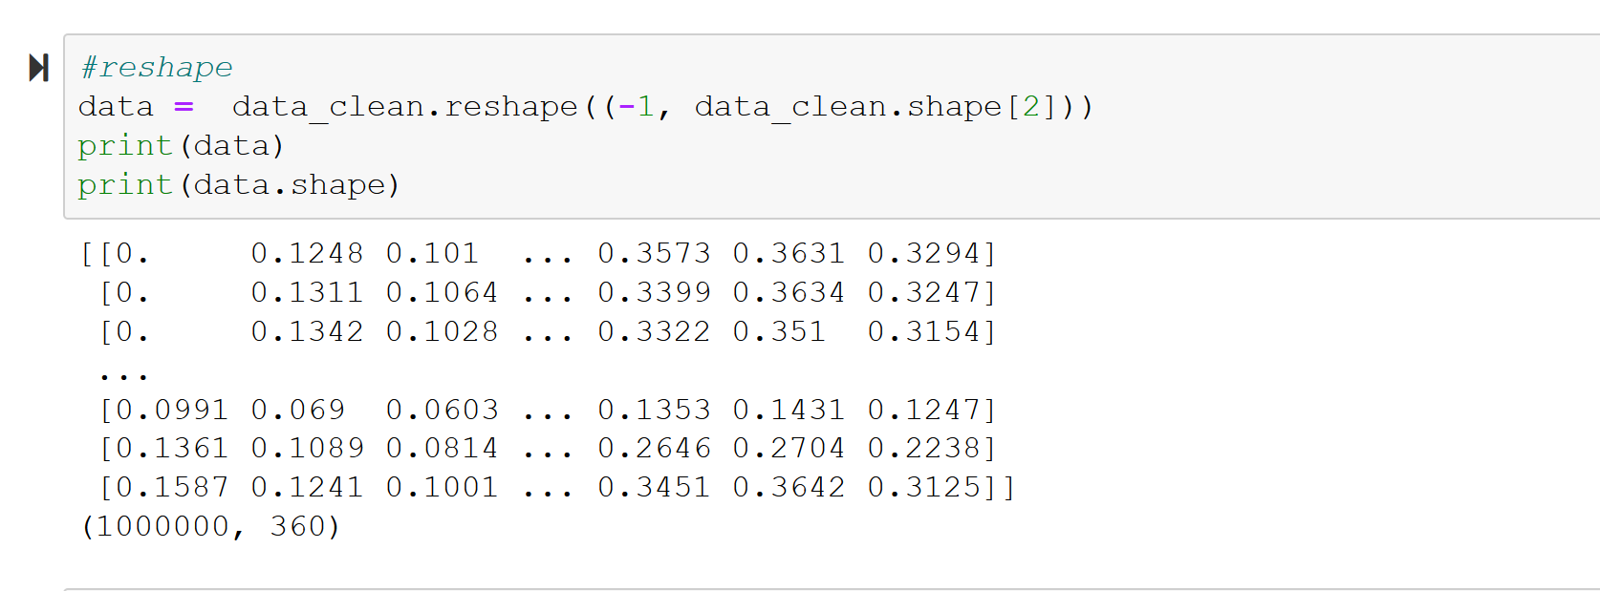
Reshape data to combine all pixels

Slide 18
Determining cluster numbers
Inertia is the sum of squared error for each cluster

Slide 19
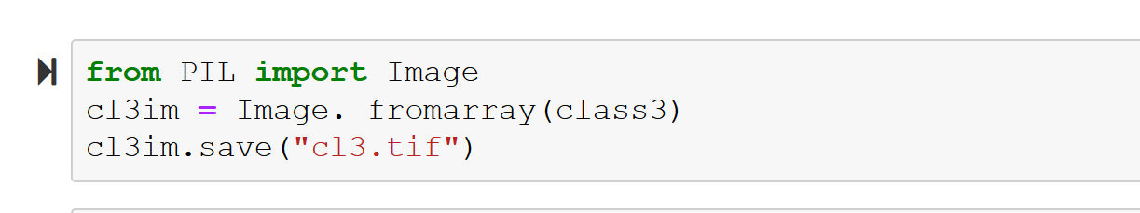
Pure Pixel classification: K-Means Clustering
Creating Model
Running classification
Reshaping back to 2D image
Saving as a general tif like a camera image

Slide 20
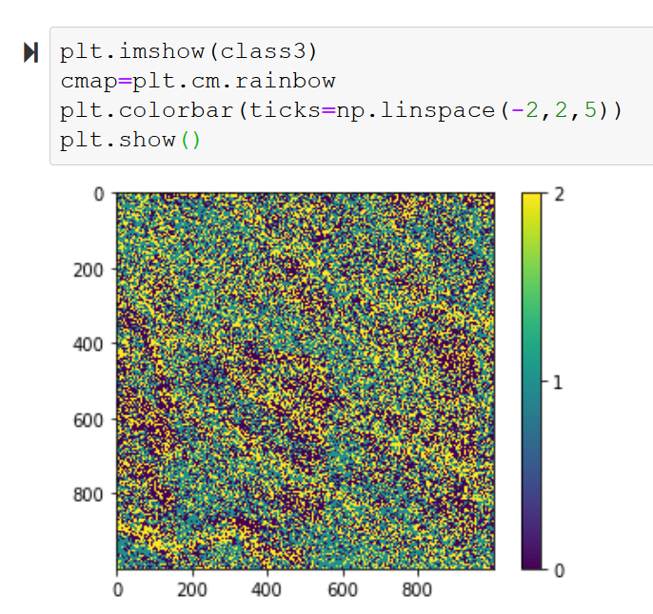

Slide 21
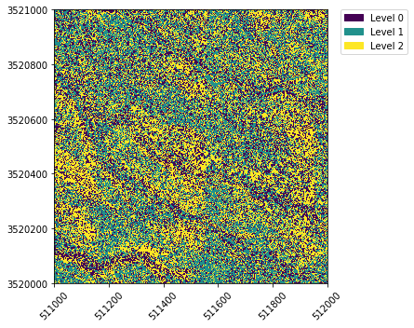
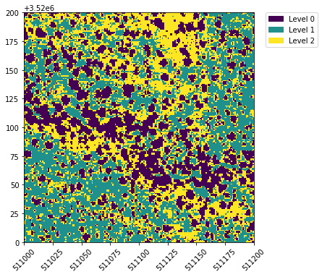
Pure Pixel classification: K-Means Clustering

Slide 22
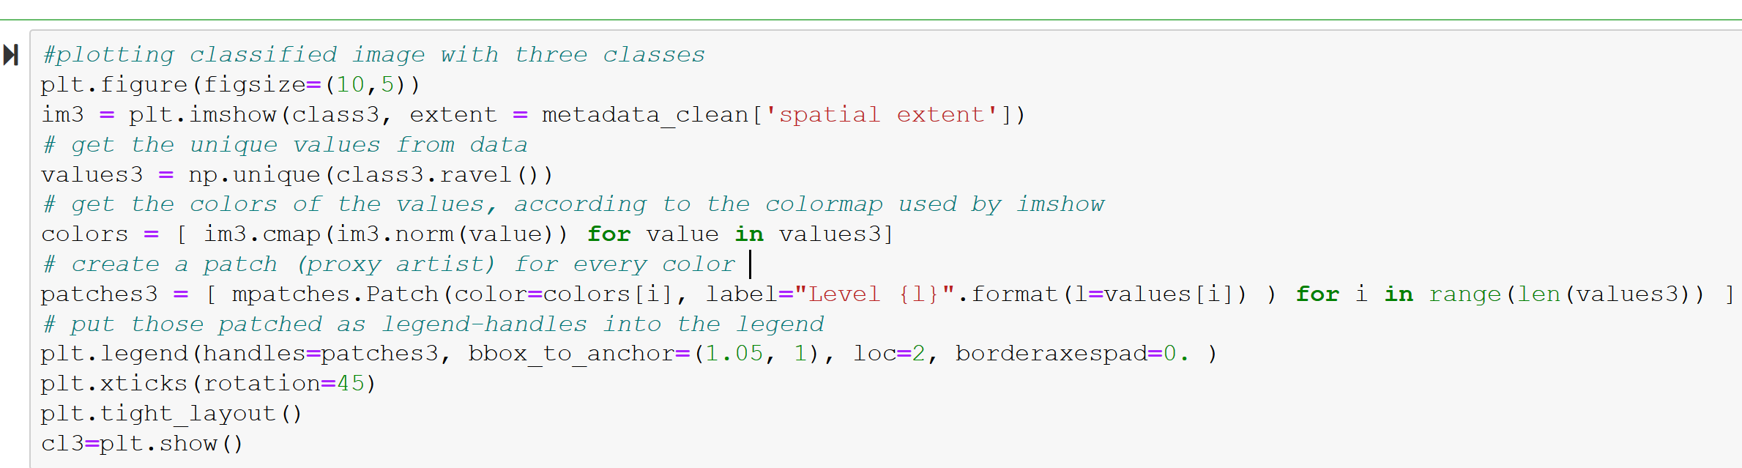
Plotting Code

Slide 23
Assigning Classes

